Slide 1
Numerical Analysis of Aqueous Humor Flow in Healthy and Glaucomatous Eyes using a MIG Stent and artificial TM.

Slide 2
Outline
01
02
03
Objective
Introduction
Methodology & results
04
05
06
Recap
Future Work
Gant Chart

Slide 3
01
Objective

Slide 4
Objective
Propose a new glaucoma treatment
Model normal and glaucomatous eye with stent and without stenting
Engineered TM
Stenting

Slide 5
02
Introduction

Slide 6
Glaucoma
Is an eye condition where the optic nerve is damaged.
It's caused by fluid building up in the front part of the eye, which increases the IOP

Slide 7
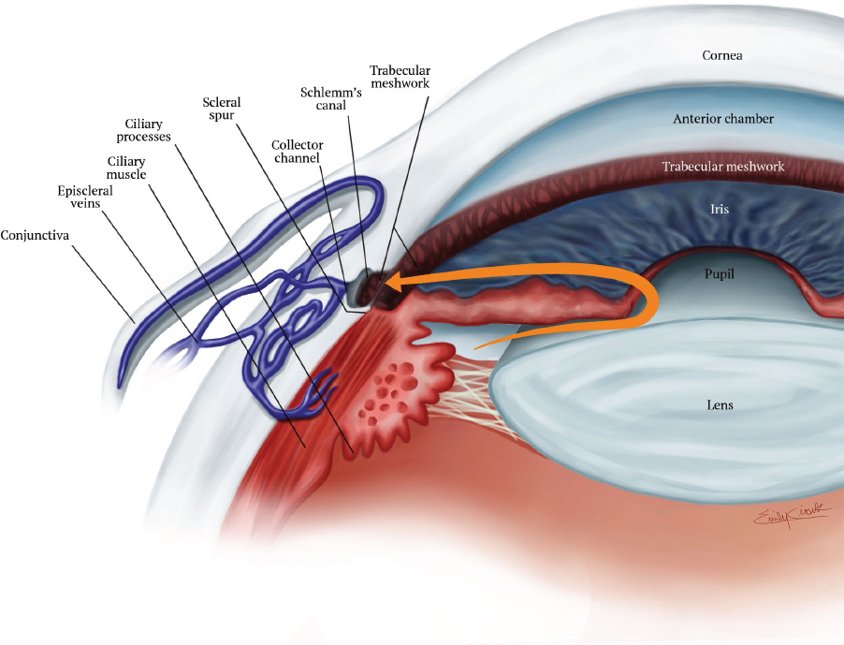
Normal Aqueous Humor Flow
https://entokey.com/structure-and-mechanisms-of-trabecular-outflow/

Slide 8
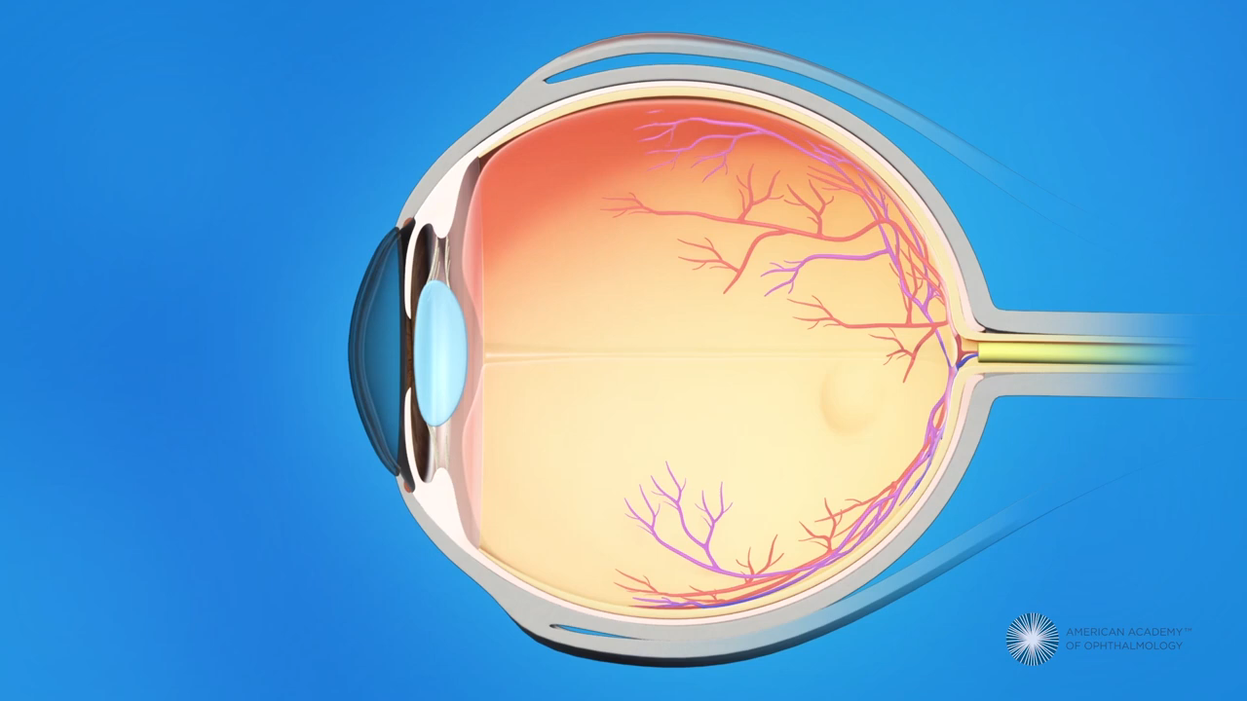
Primary Open Angle Glaucoma

Slide 9
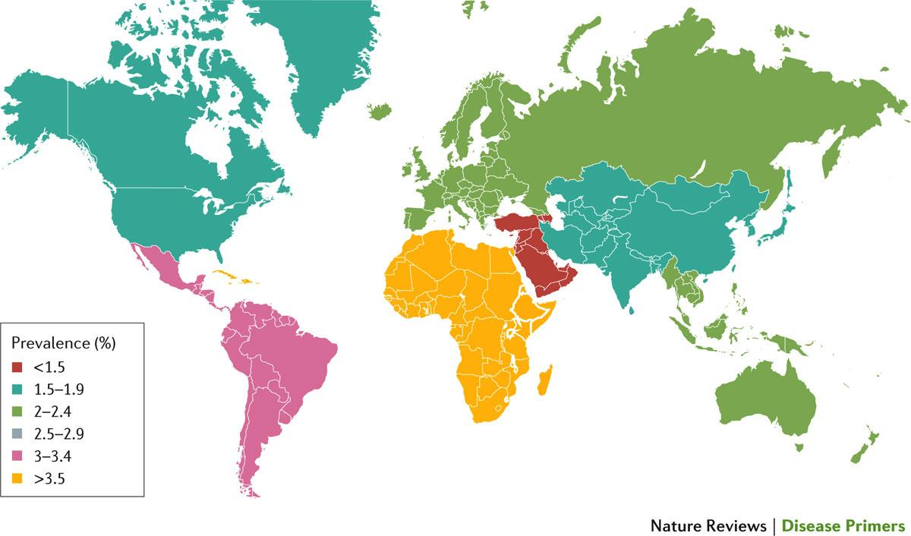
Global prevalence of primary open-angle glaucoma
12% of all blindness cases worldwide in 2014 s worldwide
Weinreb, R. N. et al. (2016) Primary open-angle glaucoma
Nat. Rev. Dis. Primers doi:10.1038/nrdp.2016.67
Notes:
For individuals ≥40 years of age, the population prevalence data (%) in 2015 per region are colour-coded
Prevalence:s the proportion of a particular population found to be affected by a medical condition at a specific time

Slide 10
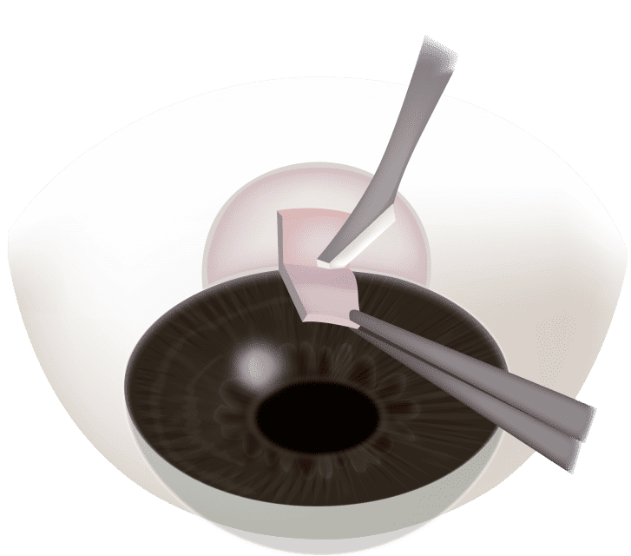
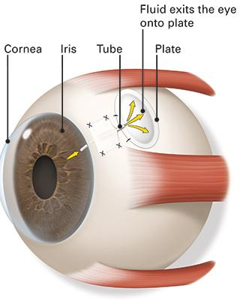
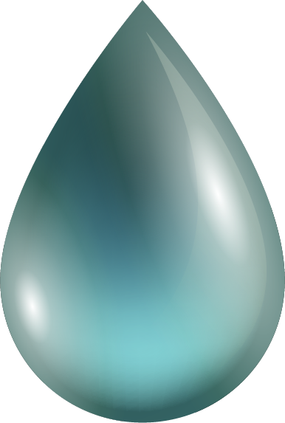
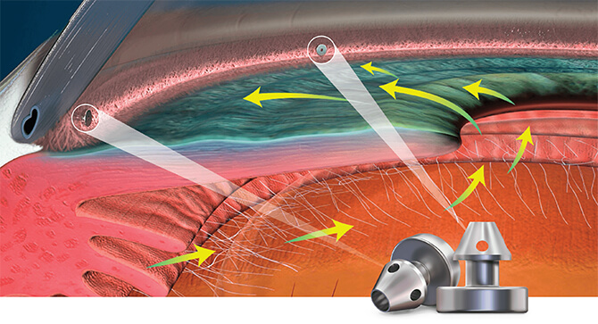
Treatments
Shunt devices
Ahmed valved Device
Eye Drops
Trabeculectomy
Laser Treatment
Destroy ciliary body cells
Open holes in the trabecular meshwork
Micro stent

Slide 11
03
Methodology

Slide 12
Workflow
Eye Modelling
Modelling
FEM
Eye
Flow volume
3D modelling
Outer structure
Meshing
TM, SC, CC
Posterior eye
Fluid analysis
Tissue engineered TM
Structural analysis
Stent

Slide 13

Finite element analysis
By using material properties and boundary conditions of aqueous humor fluid and eye layers that we connected from published papers, we managed to see the fluid simulation, pressure contour, velocity streamlines and wall sheer stress that results from the flow.

Slide 14
Main steps for using FEM are as follows:
Import Geometry parts.
Define Initial and Boundary Conditions.
1
4
Assign material & type for each part.
Specify the Analysis settings.
2
5
Mesh the geometry.
Apply Loads.
3
6
Solve.
7

Slide 15
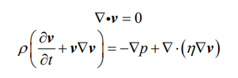
FEM equations
The fluid is modeled using the continuity and Navier-Stokes equations for incompressible Newtonian flow.
Where v, p and n are the velocity, pressure and viscosity of the fluid, respectively.

Slide 16
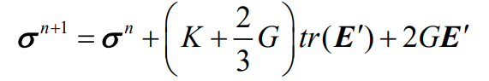
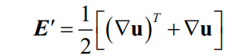
FEM equations
The stress in the tissue is computed through the following equation
Where n and n+1 refer to successive time steps and K and G are the bulk and shear moduli of the tissue, and is incremental displacement)

Slide 17
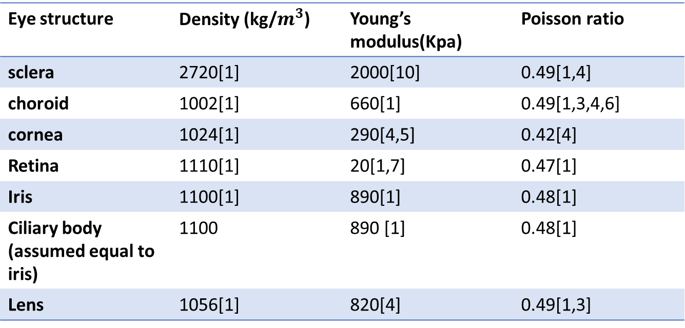
Assigning material properties

Slide 18
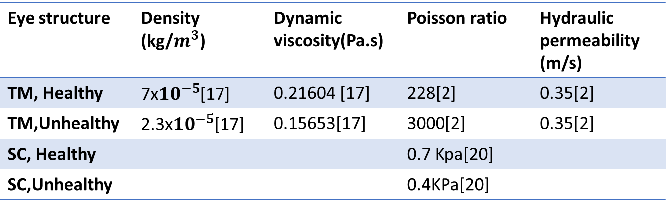

Slide 19
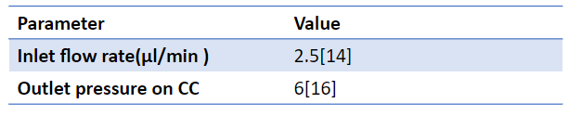
Boundary Conditions

Slide 20
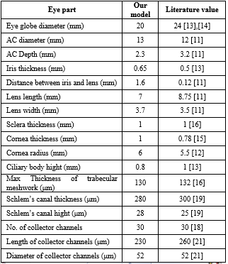
Modelling
Data collection

Slide 21
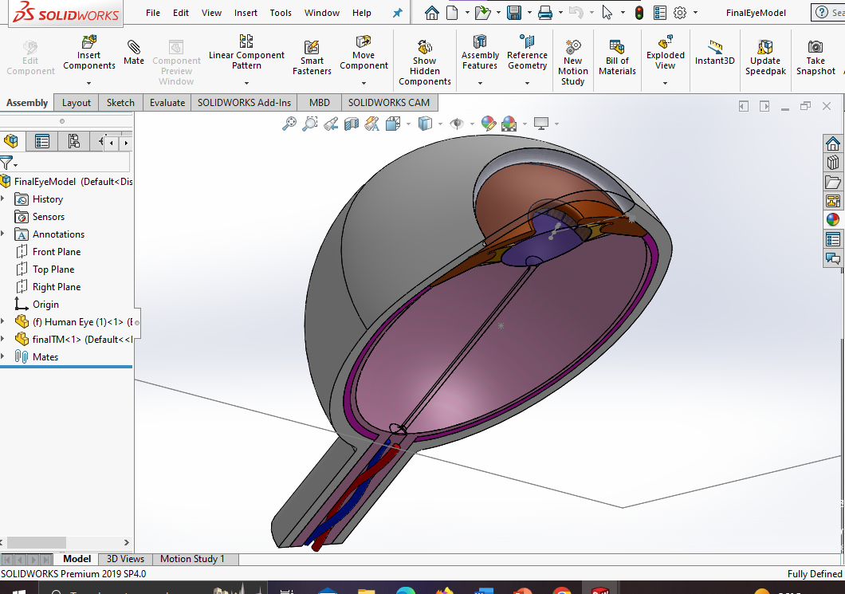

Eye
Outer structure of the eye

Slide 22
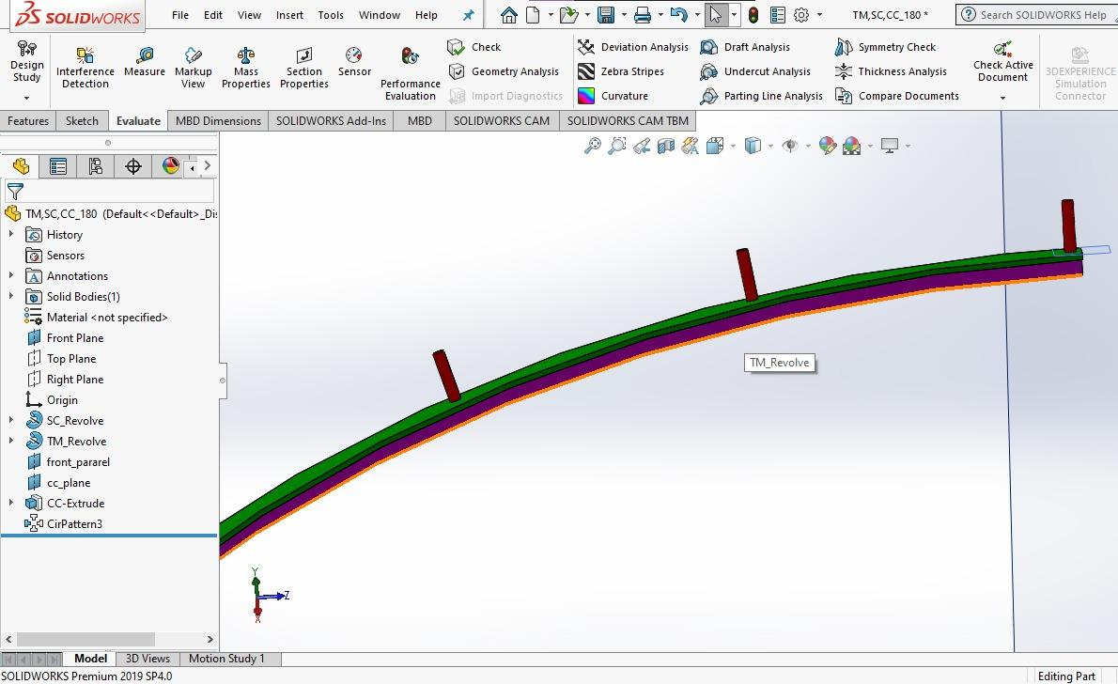


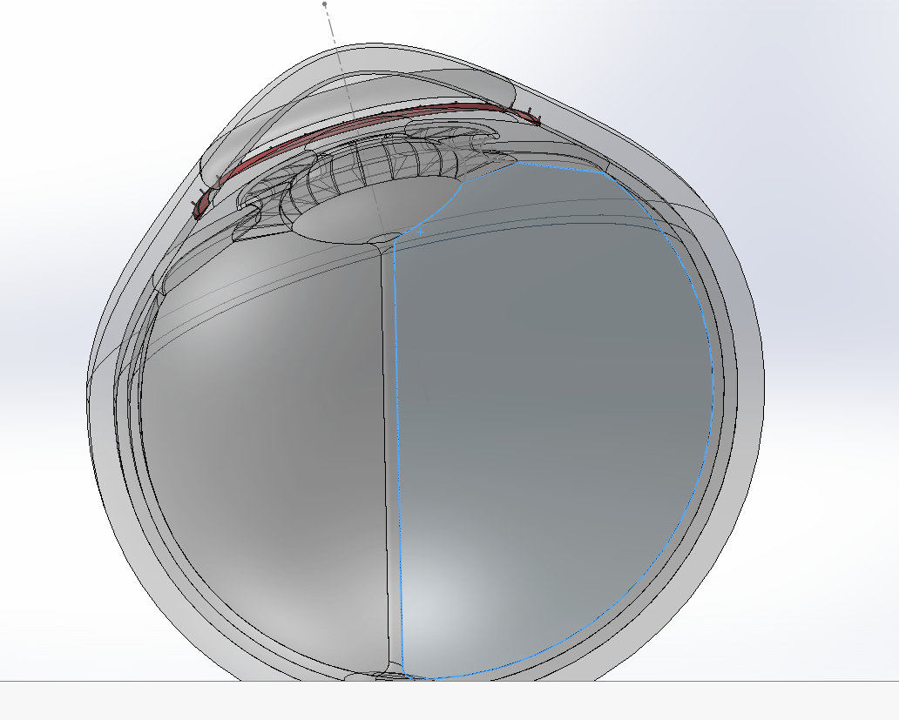
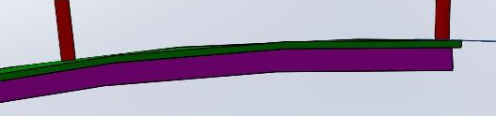
Structures of interest TM, SC, CC
CC
SC
TM

Slide 23
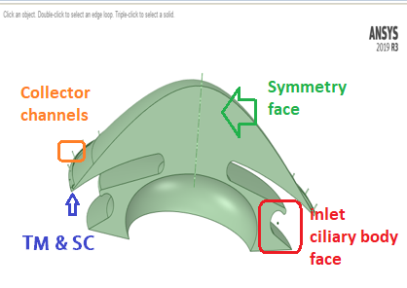
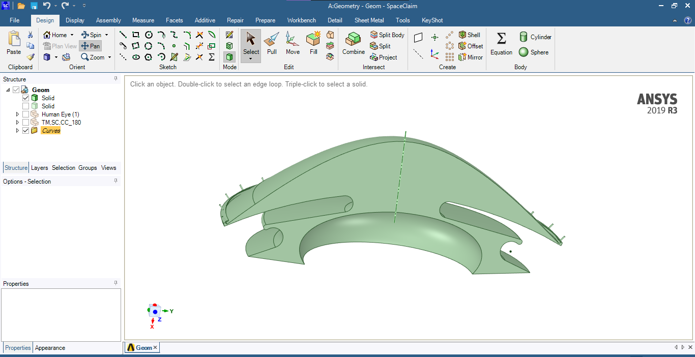
Flow Domain
Flow domain, from ciliary body to collector channels passing through the TM, SC, and CC to study the AH flow which.

Slide 24
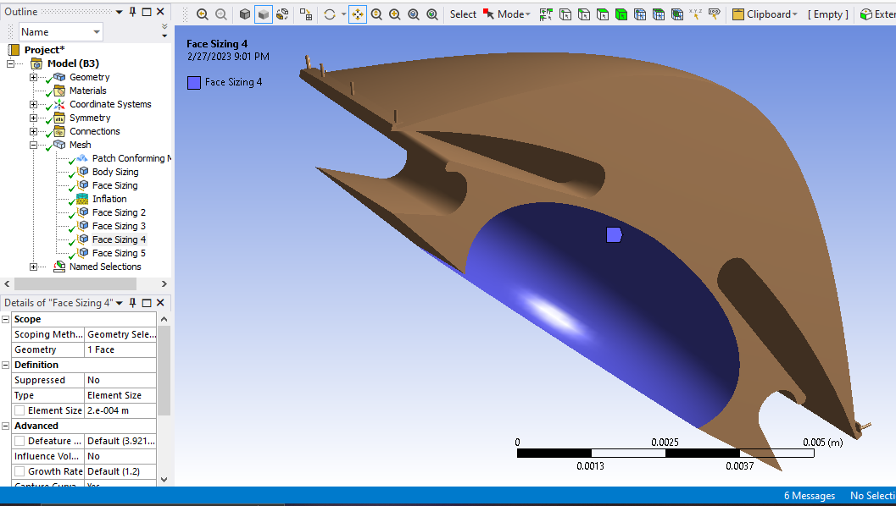
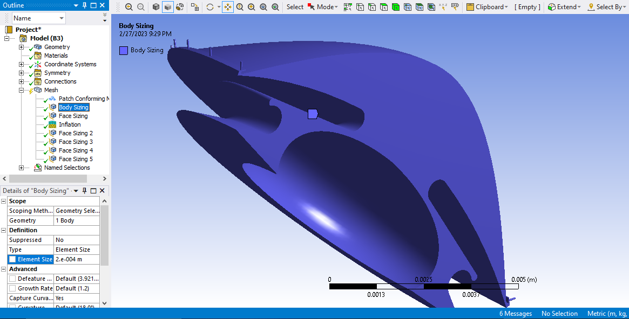
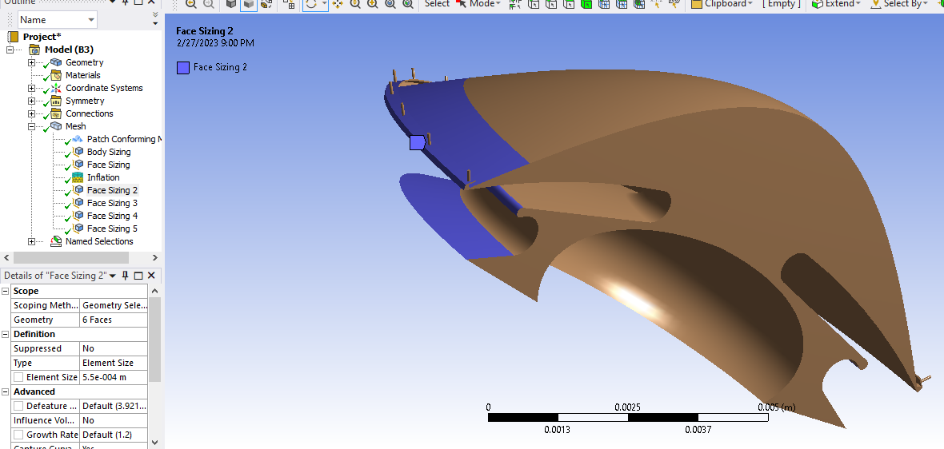
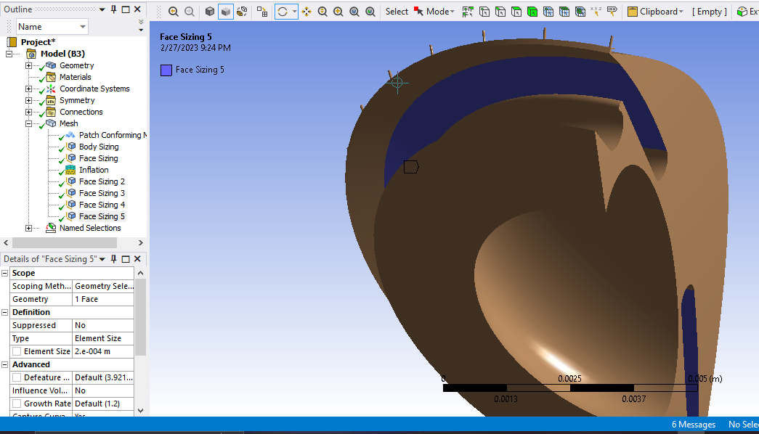
Meshing trials
Total of 40 trials
31 for the element sizes in the body and through 5 other faces
6 for the # of inflation layers
3 for the thickness of inflation layers

Slide 25
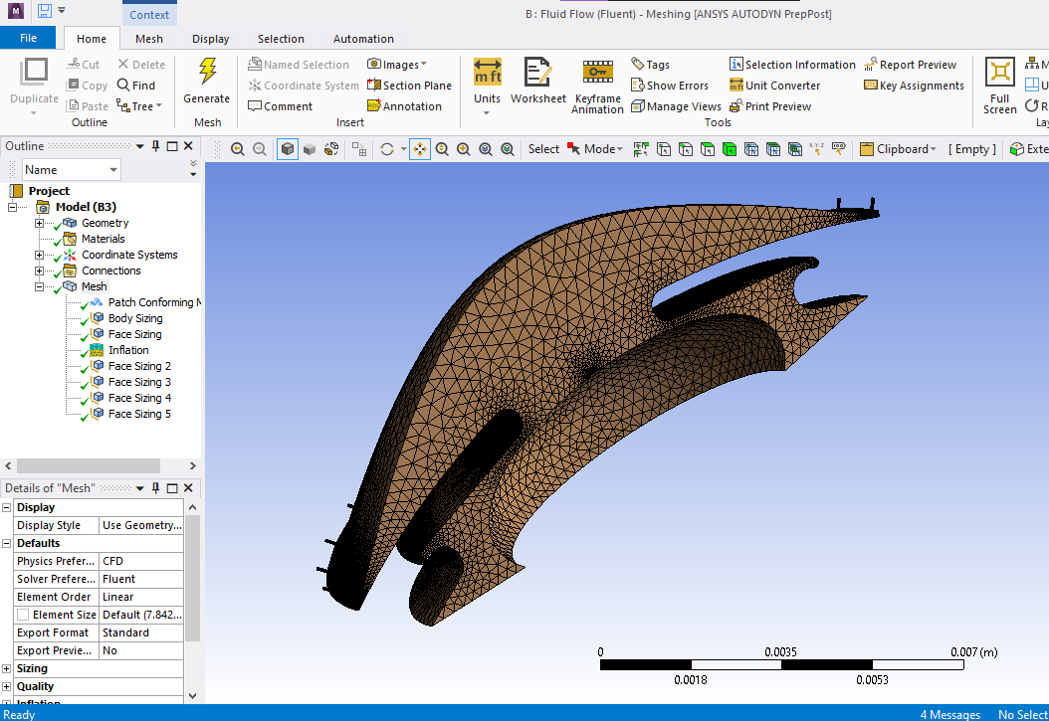
Meshing

Slide 26
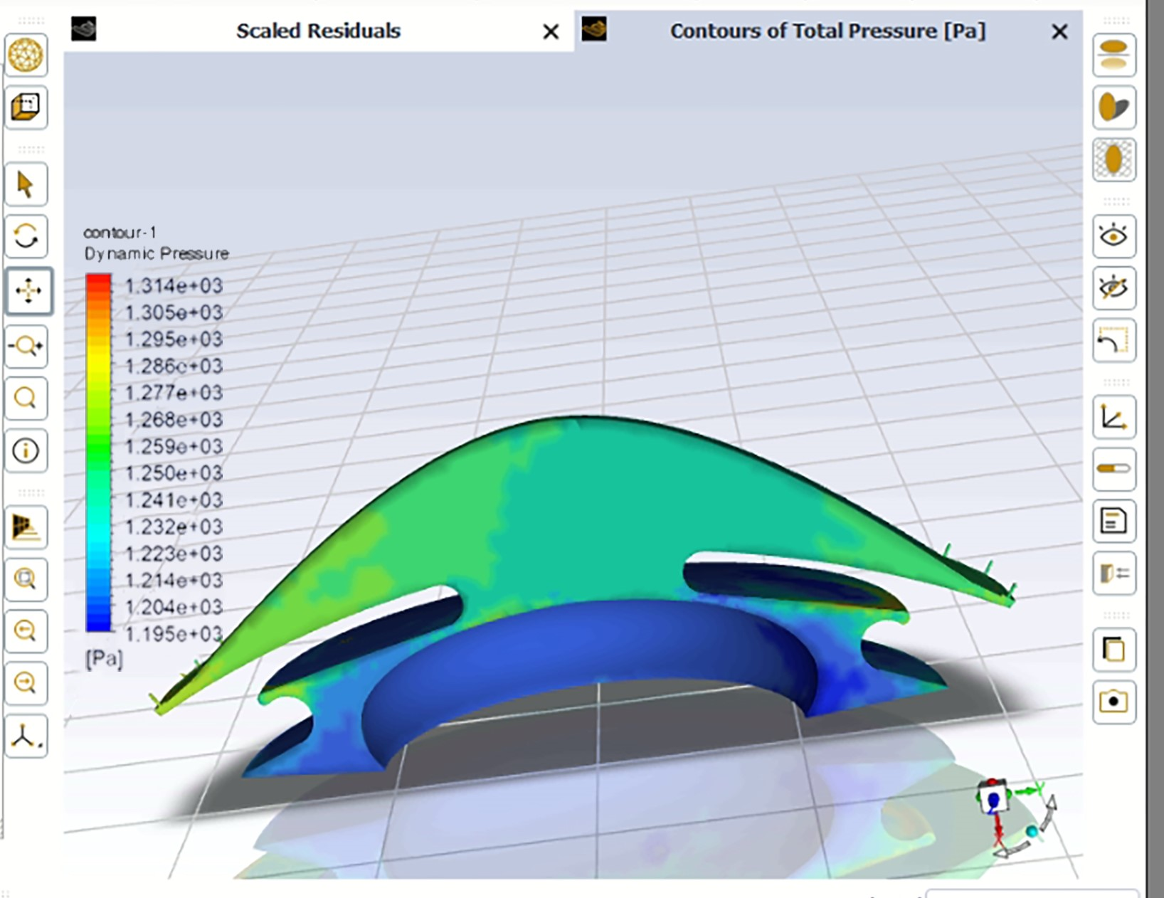
Results of normal eye
Pressure contour of the normal eye
The pressure on the flow domain which gets higher by passing through narrow spaces

Slide 27
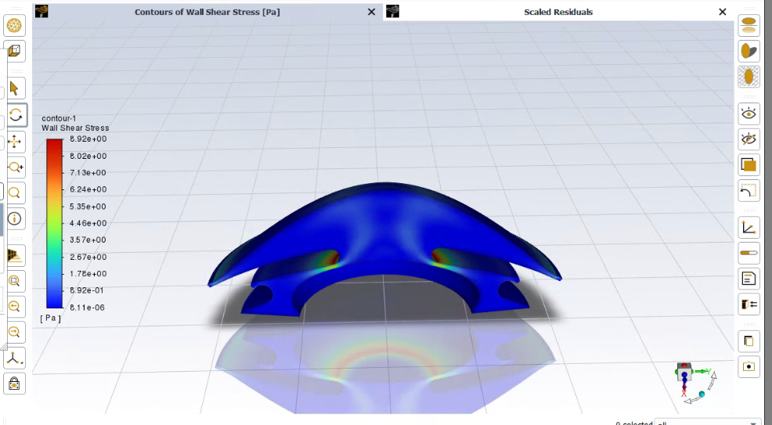
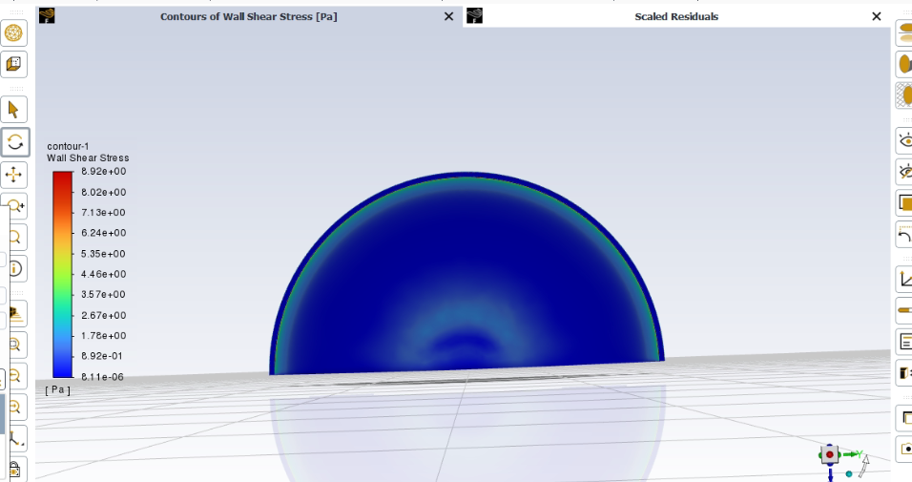
Wall sheer stress
The wall sheer stress that results from the AH flow in normal eye

Slide 28
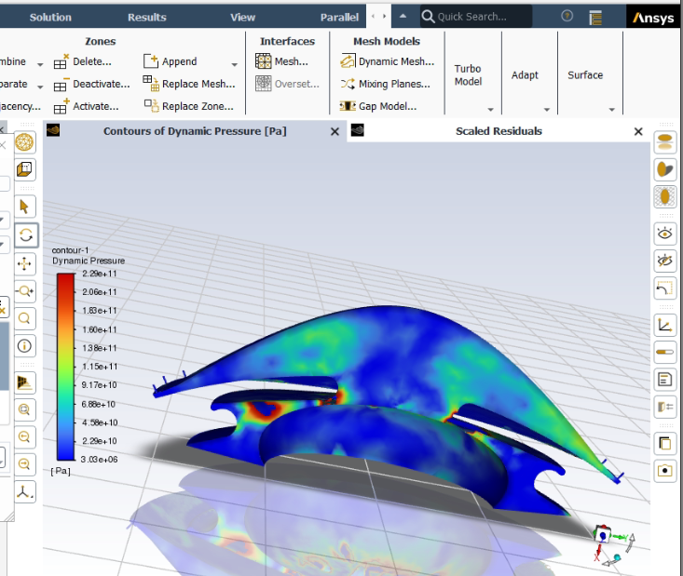
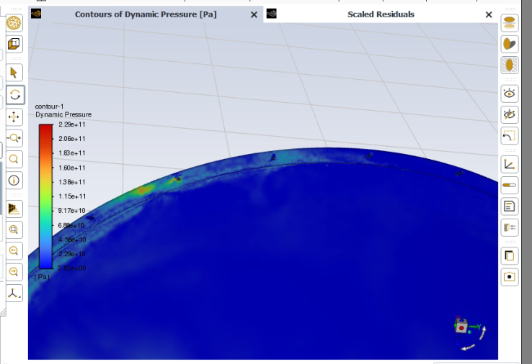
Results of glaucomatous eye
Pressure contour of the glaucomatous eye
The pressure increases as illustrated in the glaucoma condition

Slide 29
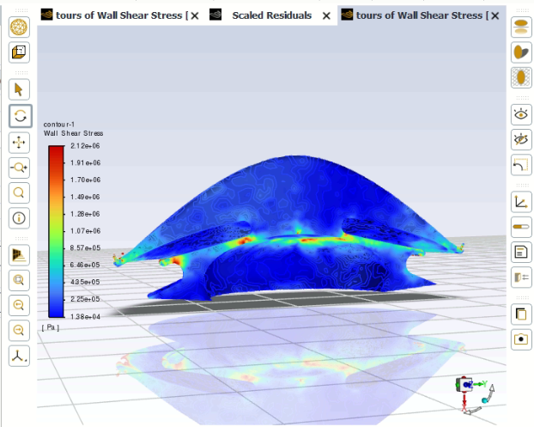
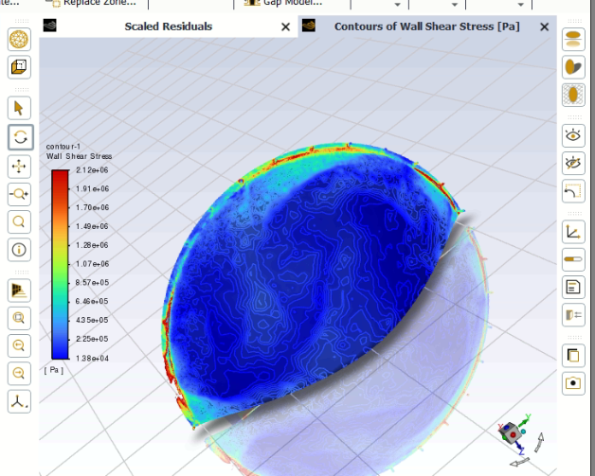
Wall sheer stress
The wall sheer stress that results from the AH flow in glaucomatous eye

Slide 30
Stent Modeling
Modeling of iStent inject which has the highest impact compared to the available stents in the market

Slide 31
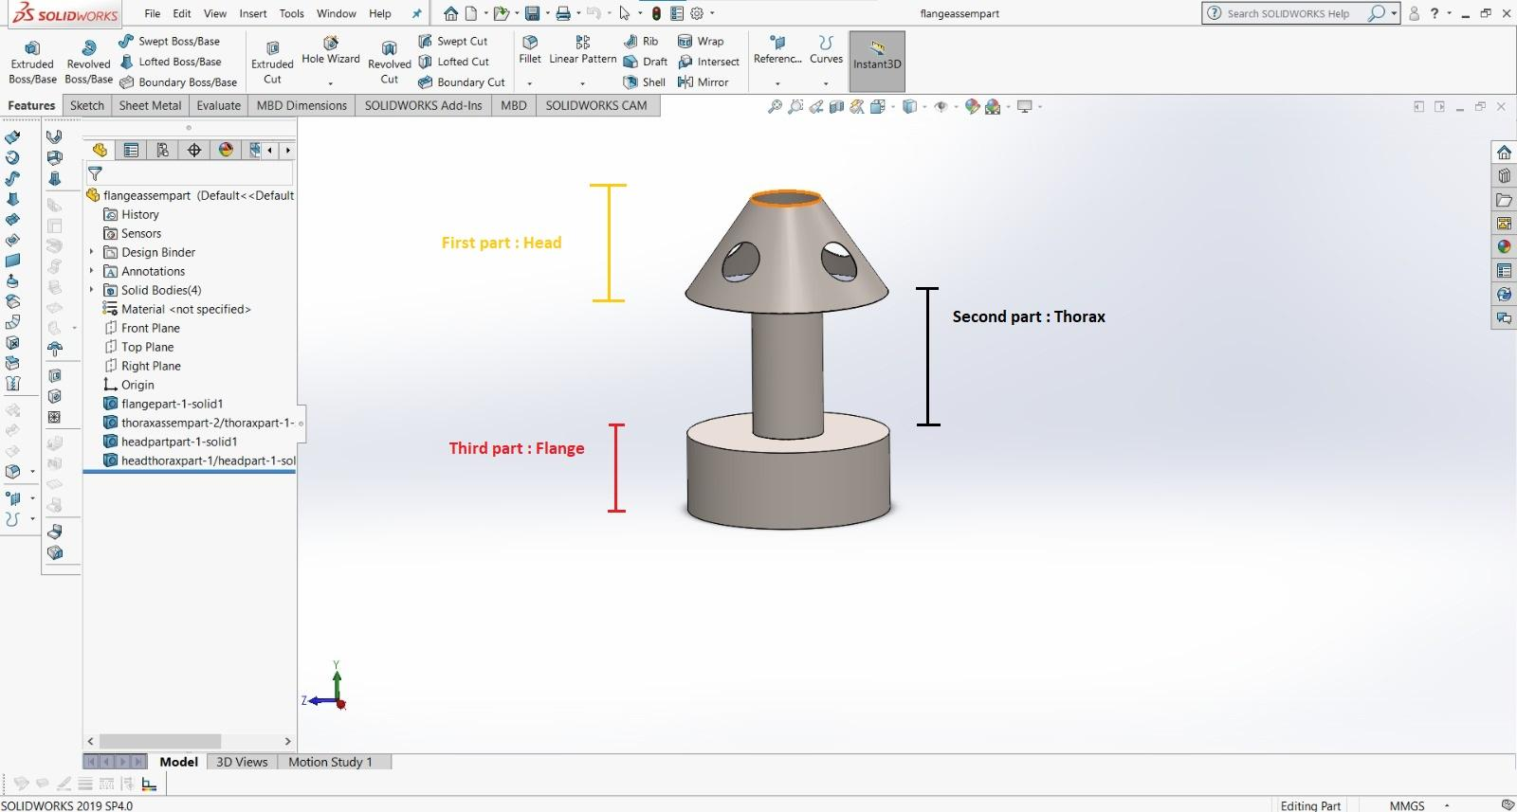
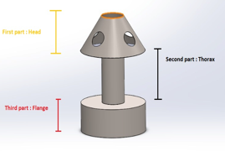
iStent inject
Head, which resides in Schlemm’s canal.
Thorax, which resides in the TM.
Flange, which resides in the anterior chamber.

Slide 32
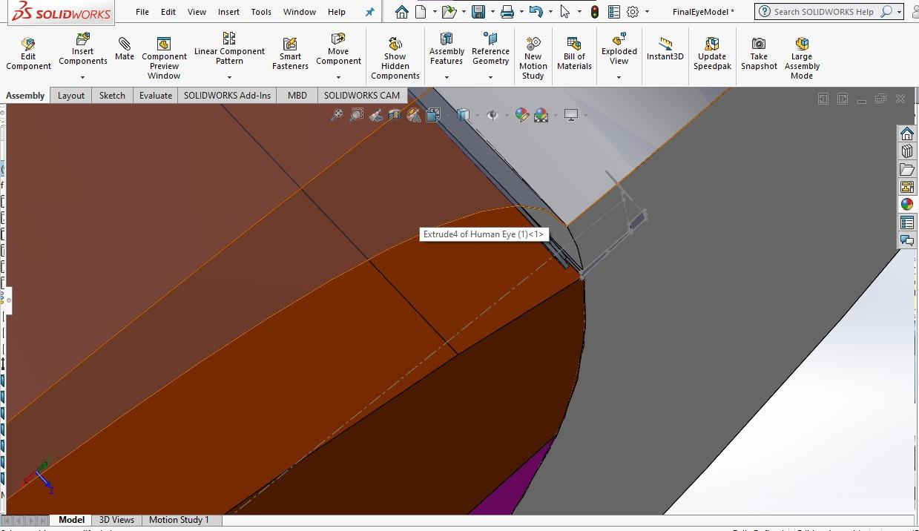
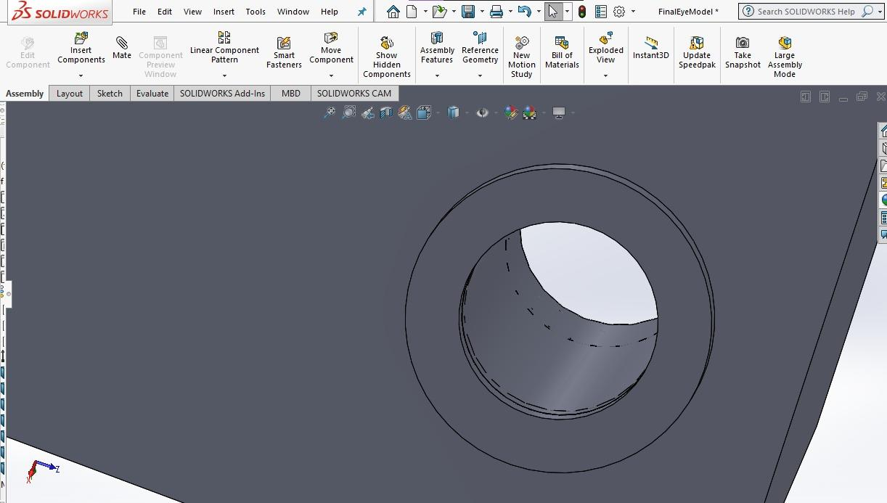
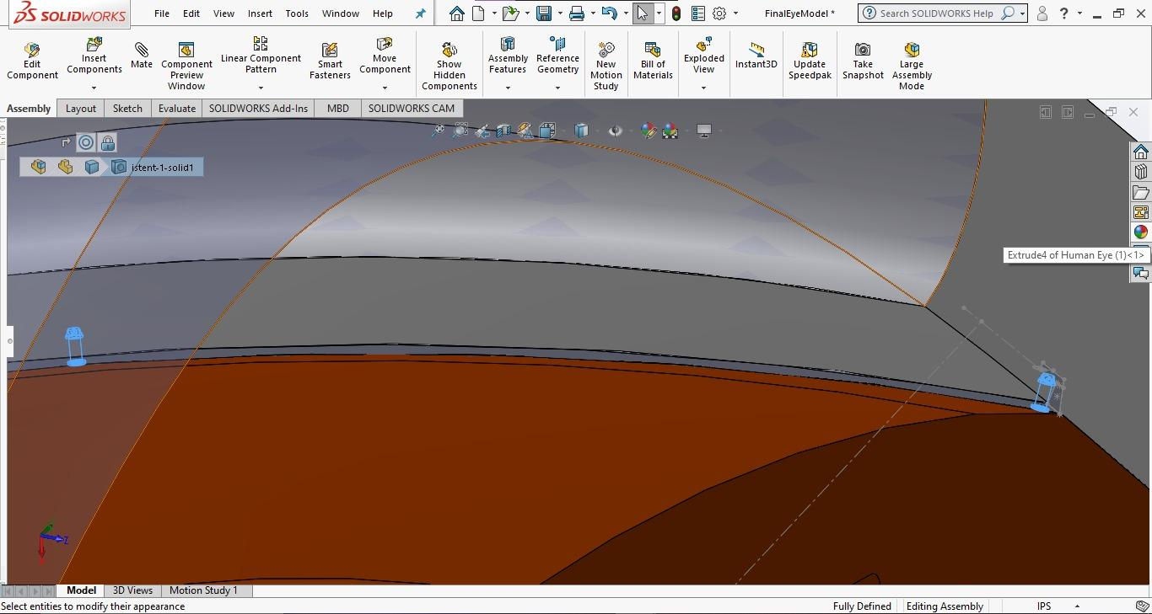
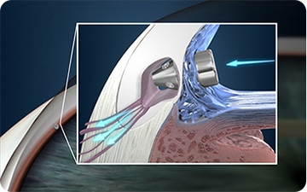
Insertion of stent
2 stents are injected 30̊ apart.
The stents are injected into the TM, SC, CC

Slide 33
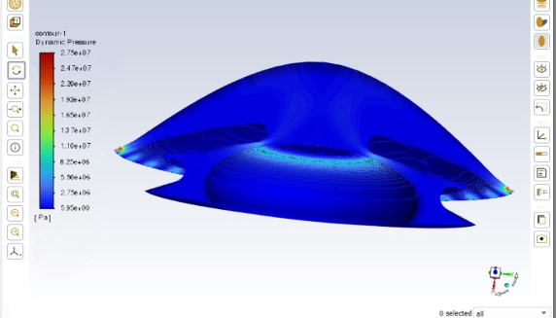
Pressure contour of the glaucomatous eye vs the eye with the iStent inject

Slide 34
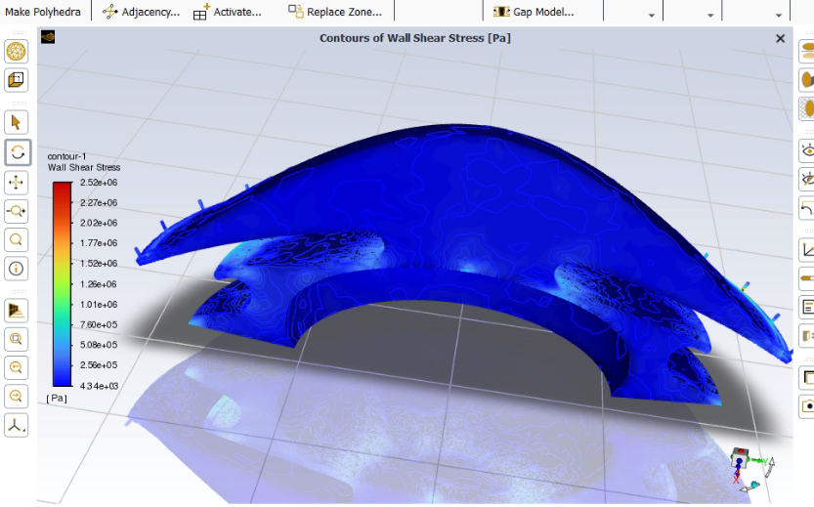
Wall sheer stress of the glaucomatous eye vs the eye with the iStent inject

Slide 35
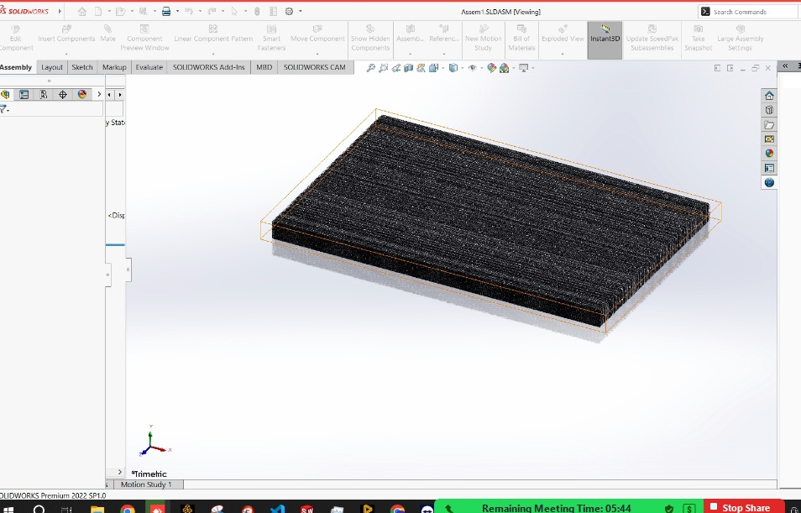
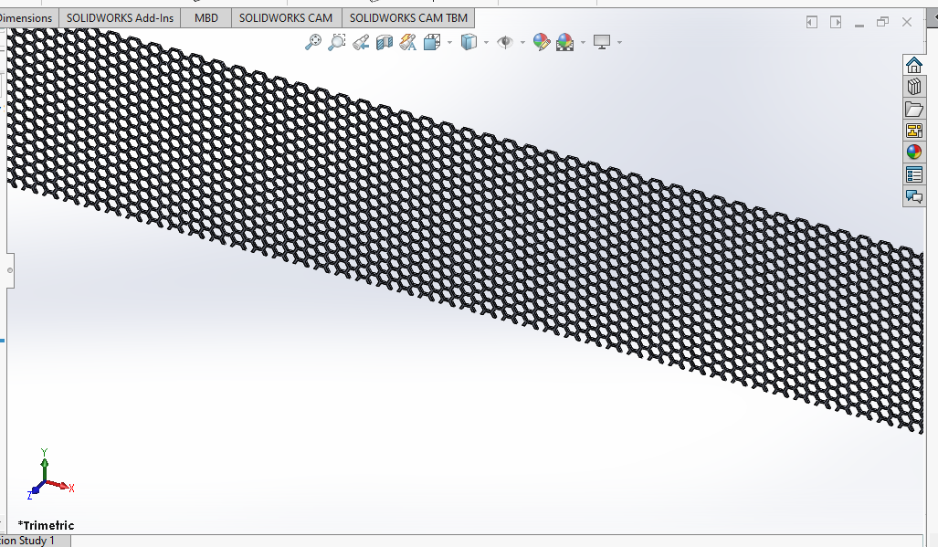
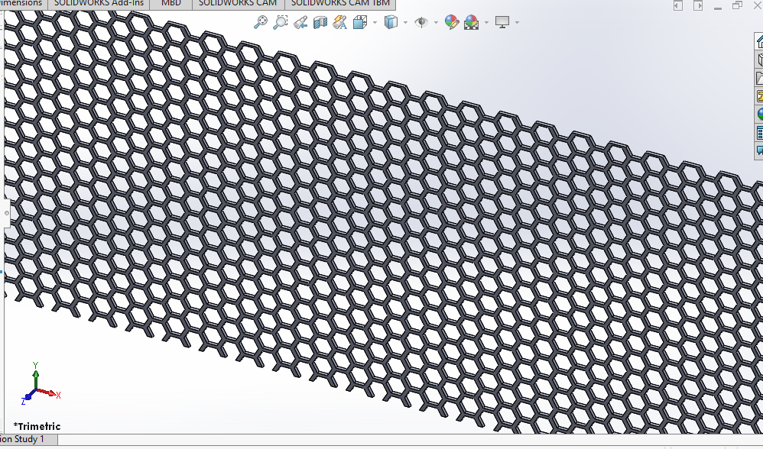
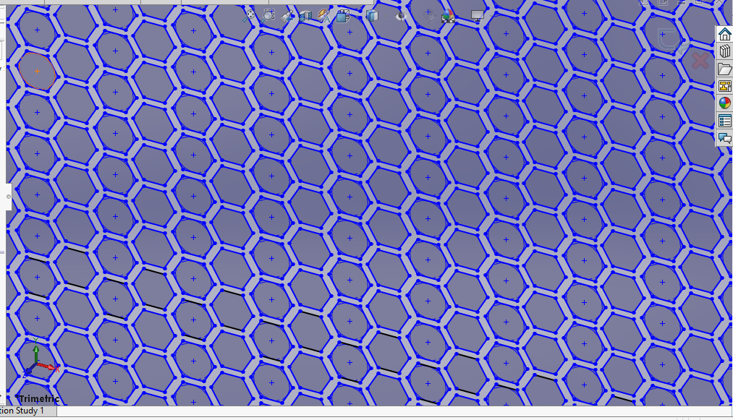
Engineered TM

Slide 36
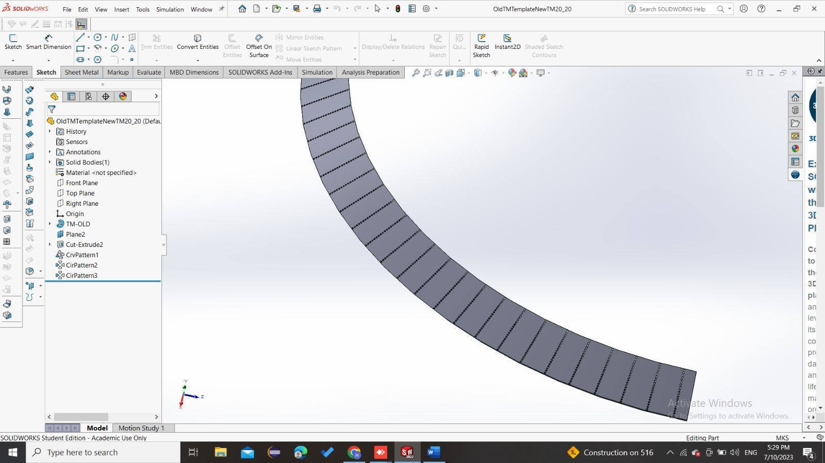
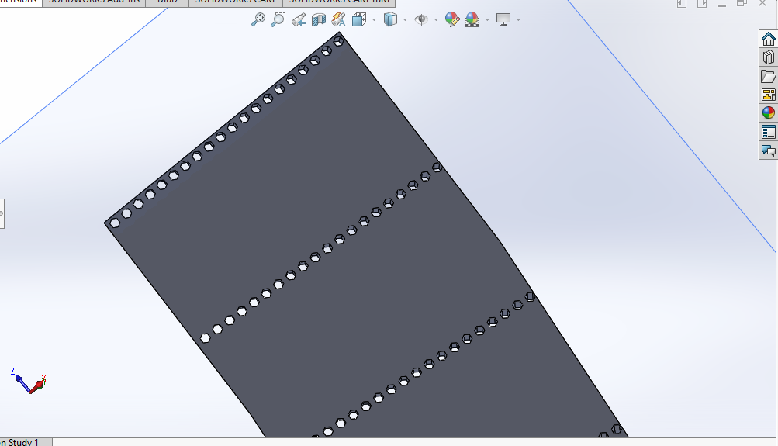
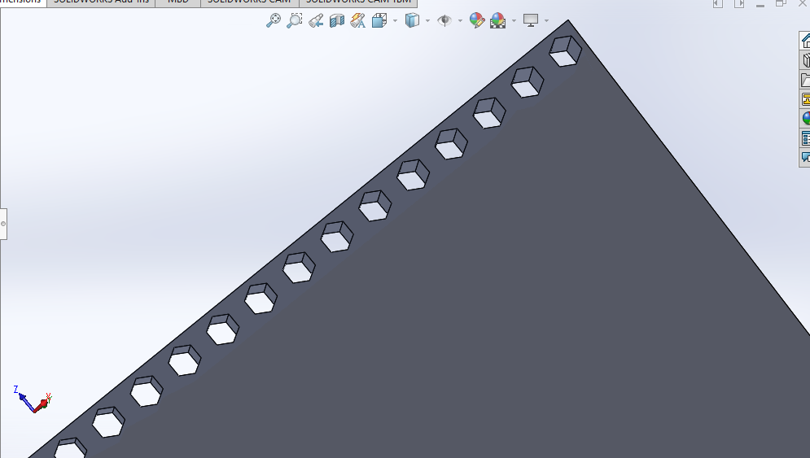
Engineered TM

Slide 37
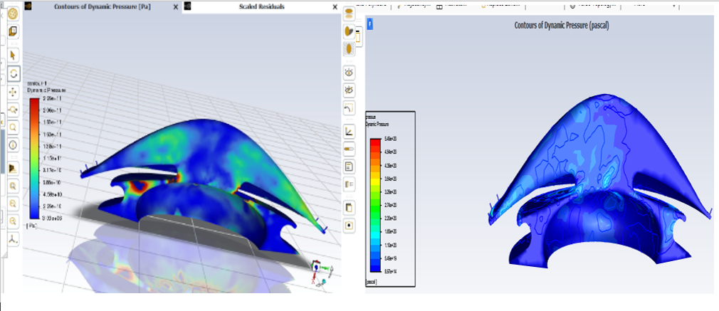
Pressure contours of the glaucomatous vs the eye with engineered TM

Slide 38
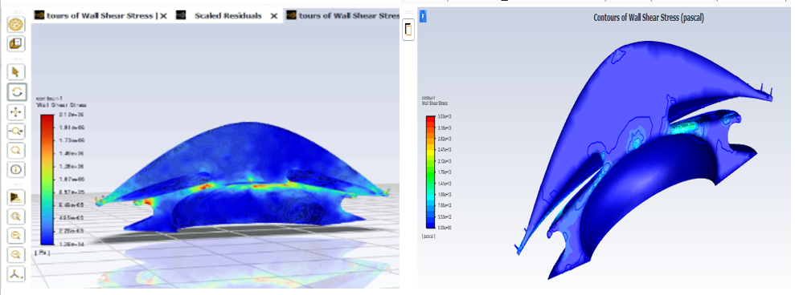
Wall sheer stress of glaucomatous eye vs eye with engineered TM

Slide 39
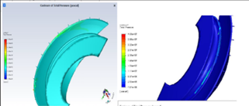
hot areas in pressure contours of engineered TM with 20x50 mesh(right) vs 20x100 mesh(left)

Slide 40

Posterior eye
Data collection

Slide 41

Posterior eye

Slide 42

Meshing
Body element size(m) | 2e-4
Pia mater face element size(m) | 4e-4
Max skewness | 0.8997
Min orthogonal quality | 0.10029
Max aspect ratio | 8.95

Slide 43
Assigning material properties
(Posterior model)
Eye structure | Young’s modulus(MPa) | Poisson ratio
LC | 0.3[3] | 0.49[3]
PLNT | 0.03[3] | 0.47[7,8]
Pia matter | 3[3] | 0.49[3]
Dura mater | 9[3] | 0.49[3]
Vessel | 5[3] | 0.49[3]

Slide 44

Boundary Conditions & Loading Conditions
Three Displacements
Three pressures

Slide 45




Results of posterior eye
Total deformation of normal eye
Total deformation of glaucomatous eye

Slide 46




Results of posterior eye
Total deformation using eye stent inject
Total deformation using Tissue engineered TM

Slide 47
04
Future Work

Slide 48
Future work
Designing new stents geometries
Treating glaucoma via tissue engineered trabecular meshwork to replace the faulty one

Slide 49
05
Gant Chart

Slide 50


Slide 51
Team members
Hager Ashraf Helal
Haidy Sayed Hassan
Sara Mohammed Habo

Slide 52
Thank you !

